Slide 1
Preliminary Tsunami Simulation of the Mw=6.7 Earthquake Bodrum, Turkey
Bruno ADRIANO, Erick Mas, Shunichi Koshimura
Laboratory of Remote Sensing and Geoinformatics for Disaster Management
IRIDeS, Tohoku University, JAPAN

Slide 2
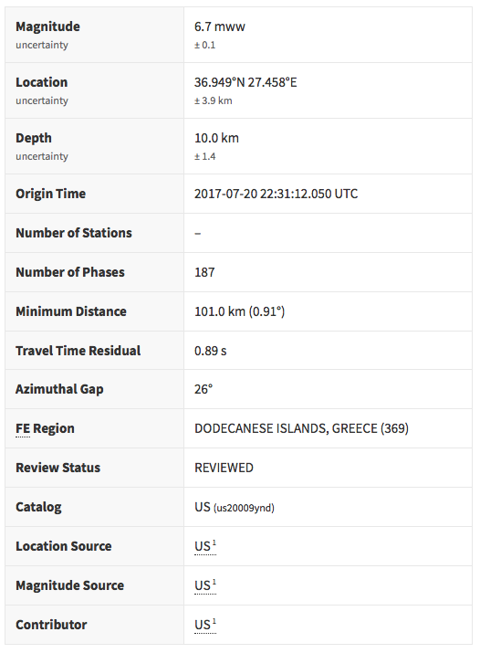
Background

Slide 3
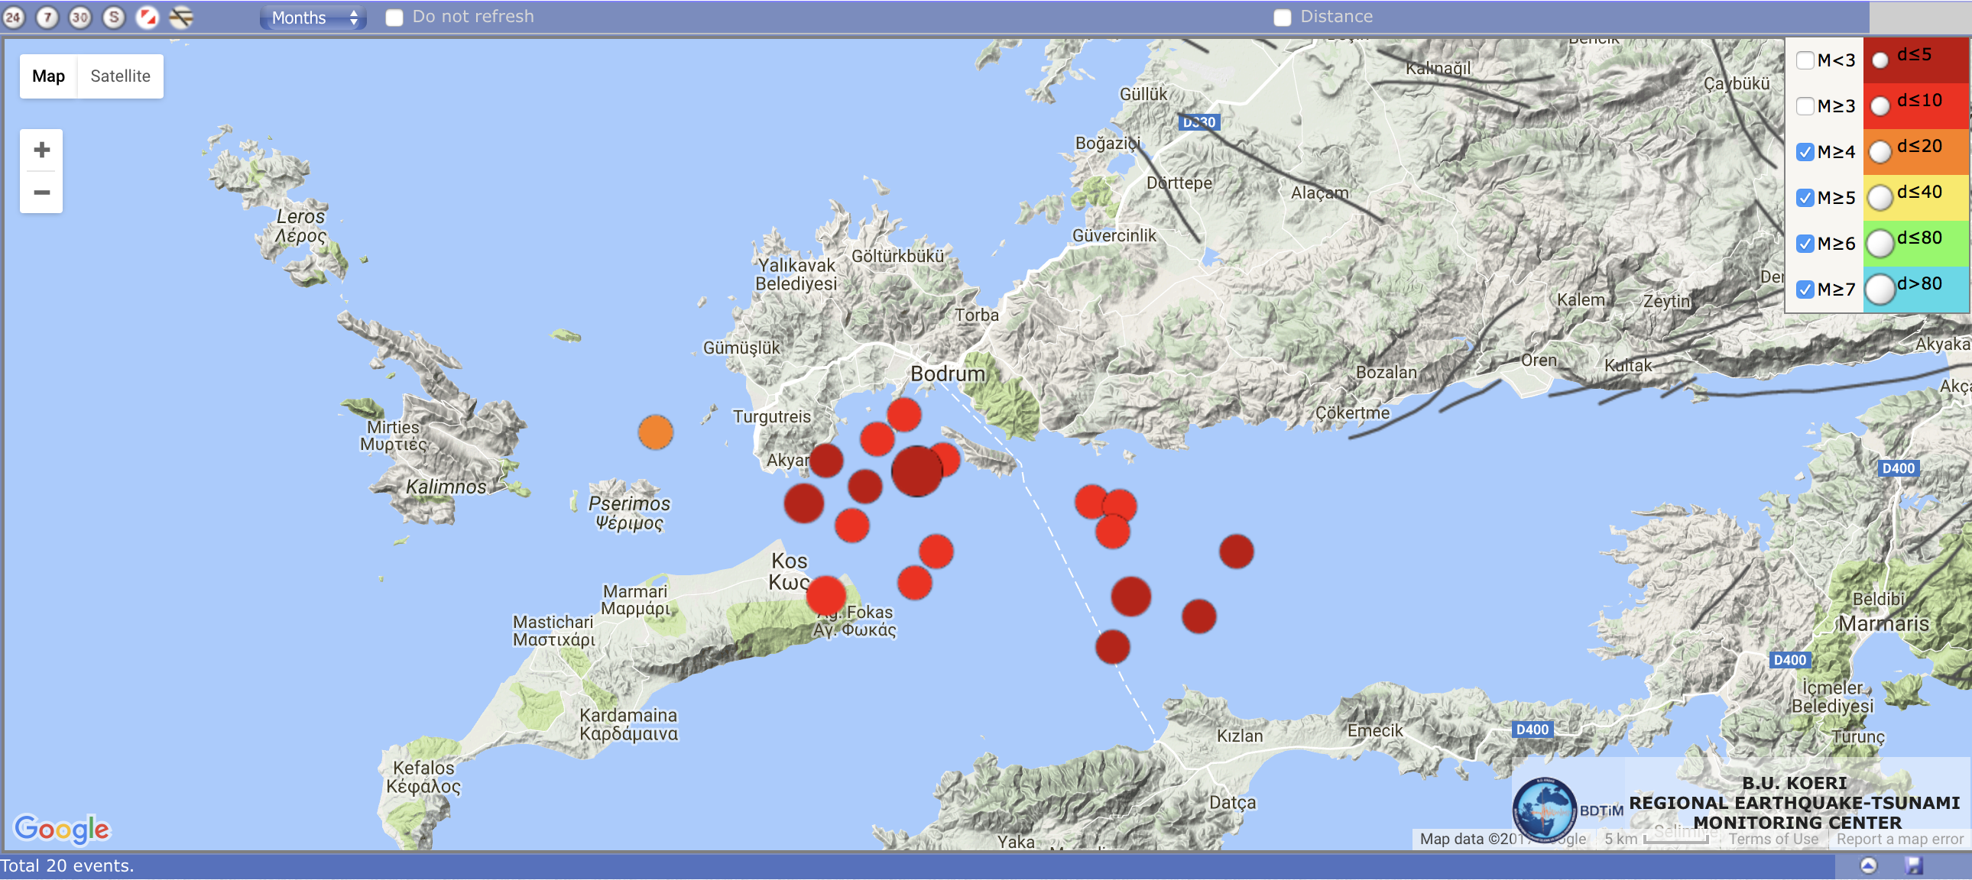
Background
Total 20 events over M4.0 within 24 hours.
http://www.koeri.boun.edu.tr/sismo/2/en/

Slide 4
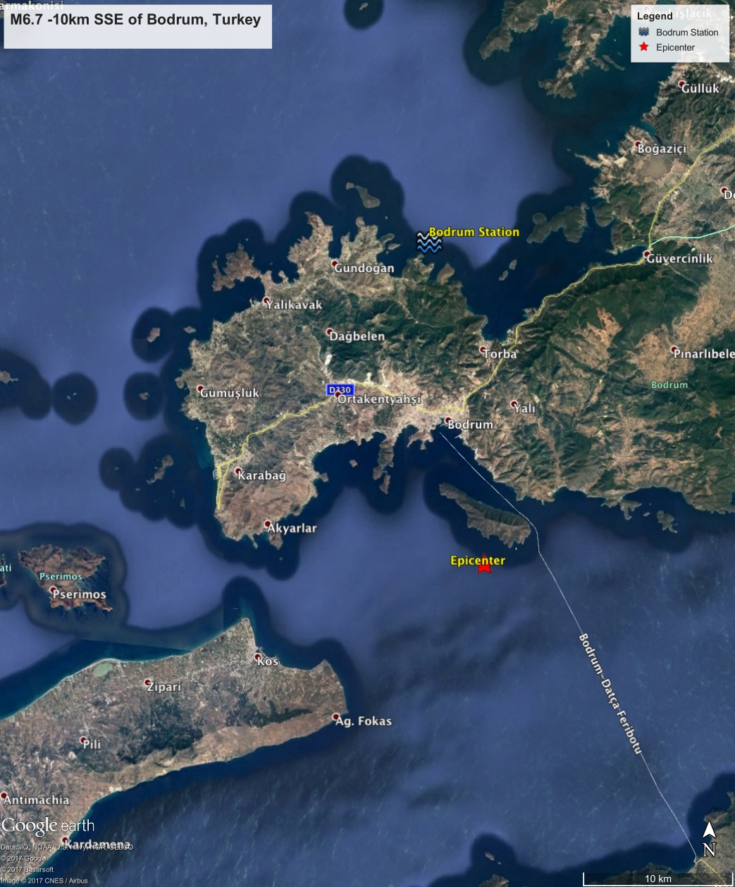
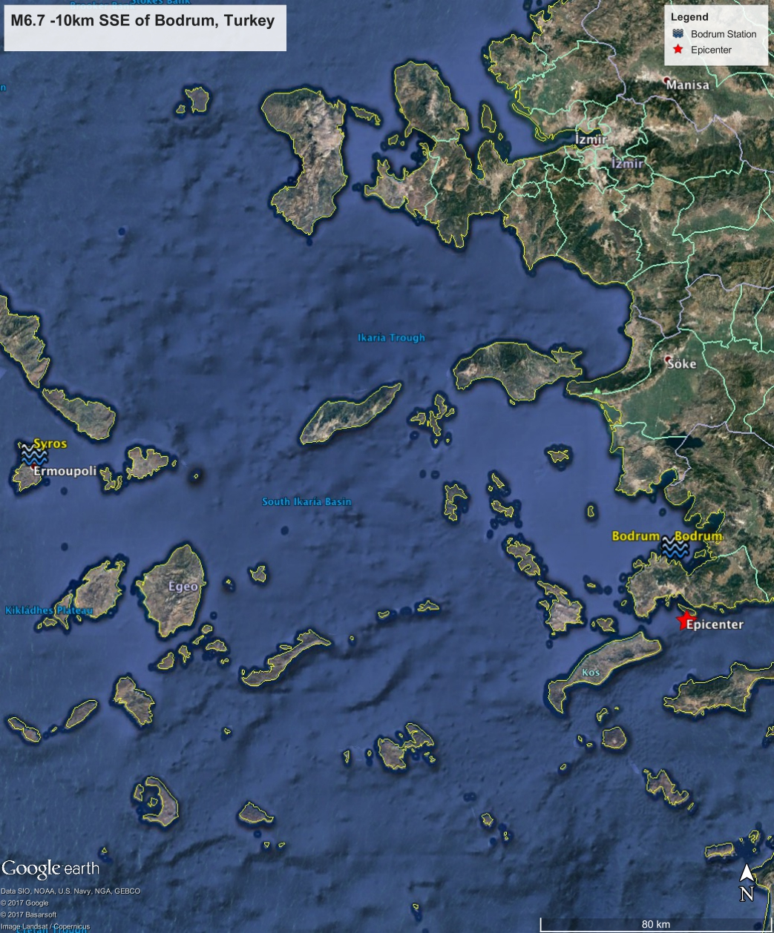
Careful: IOC Coordinates are inaccurate!
23km
10km
EQ: 22:31:12 UTC
Tsunami Arrival Time: Bodrum (~3min); Syros(~150min)
232km

Slide 5
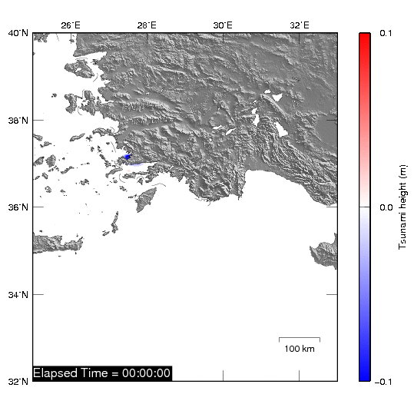
Background
ReGID Semi-Automatic Response System (SARS)
JST time
EQ: 04:31:12
SARS Alert: 07:55:31
(3h24min later?! USGS?)
SARS Results: 08:17:03
(22min Calculation, Plots and Publish)

Slide 6
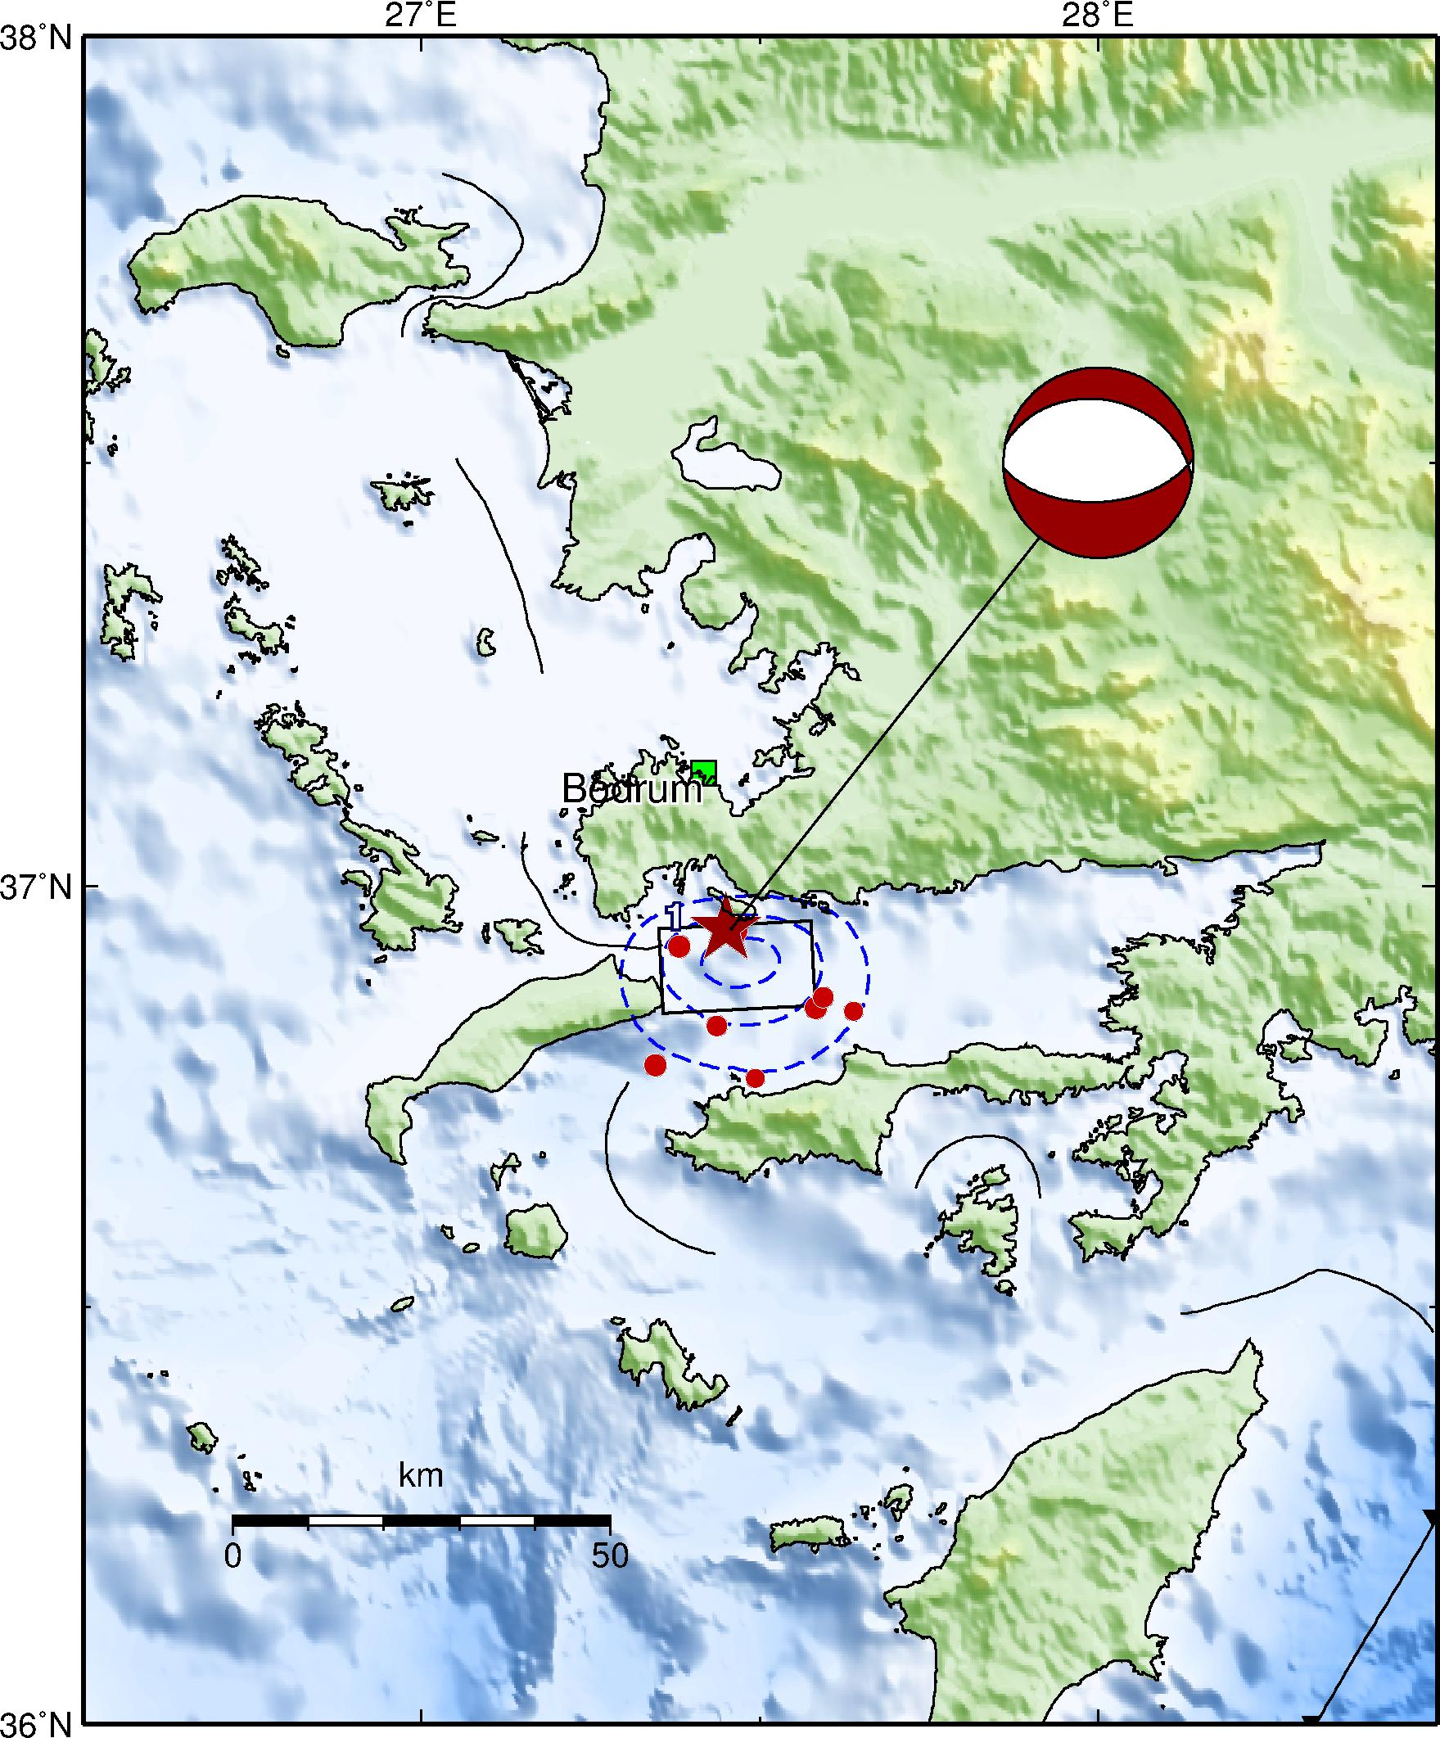

Earthquake Sources
USGS W-phase Moment Tensor solution
NP1 (Strike=87°, Dip=56°, Strike=-98°)
NP2 (Strike=281°, Dip=34°, Strike=-78°)
L =20 km
W = 20km
Slip = 0.7m

Slide 7
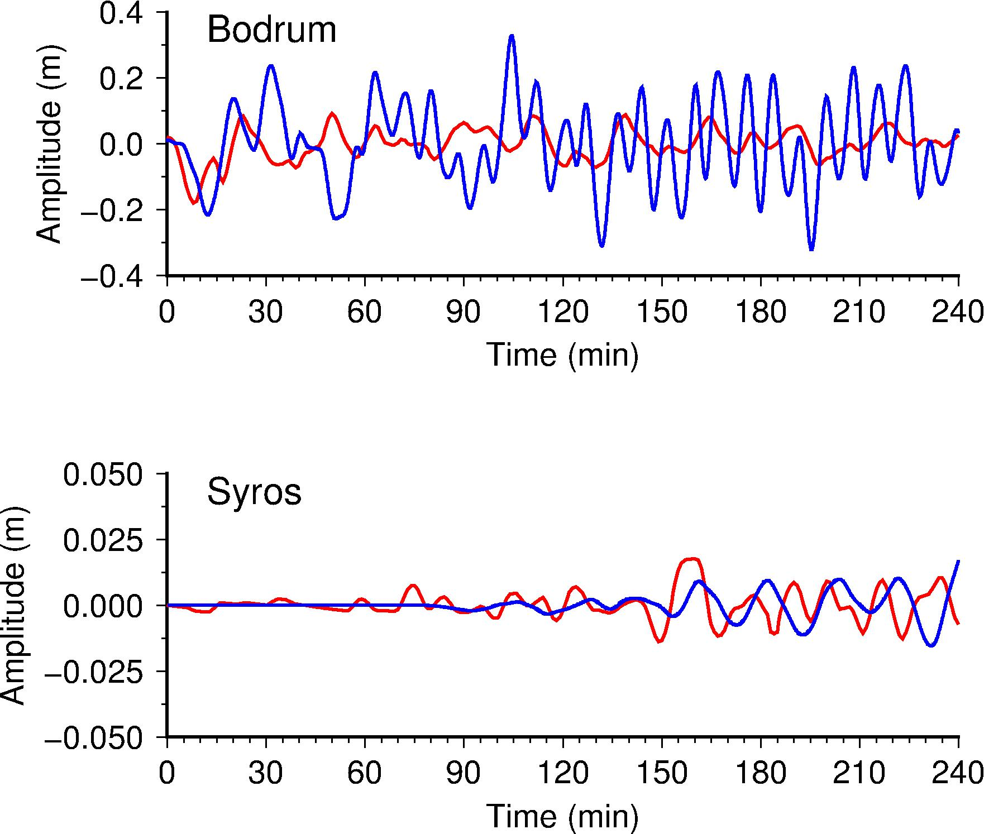
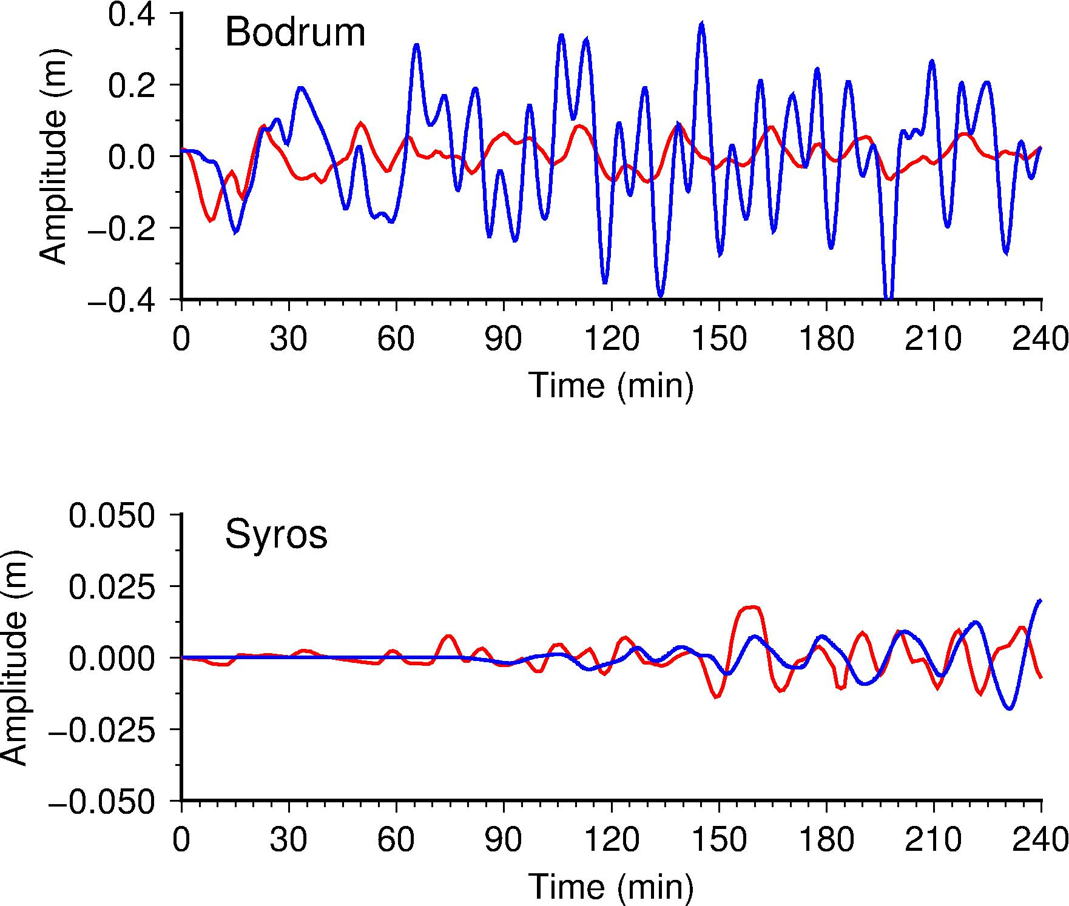
Comparison with Observed Data
Case NP1
Case NP2

Slide 8
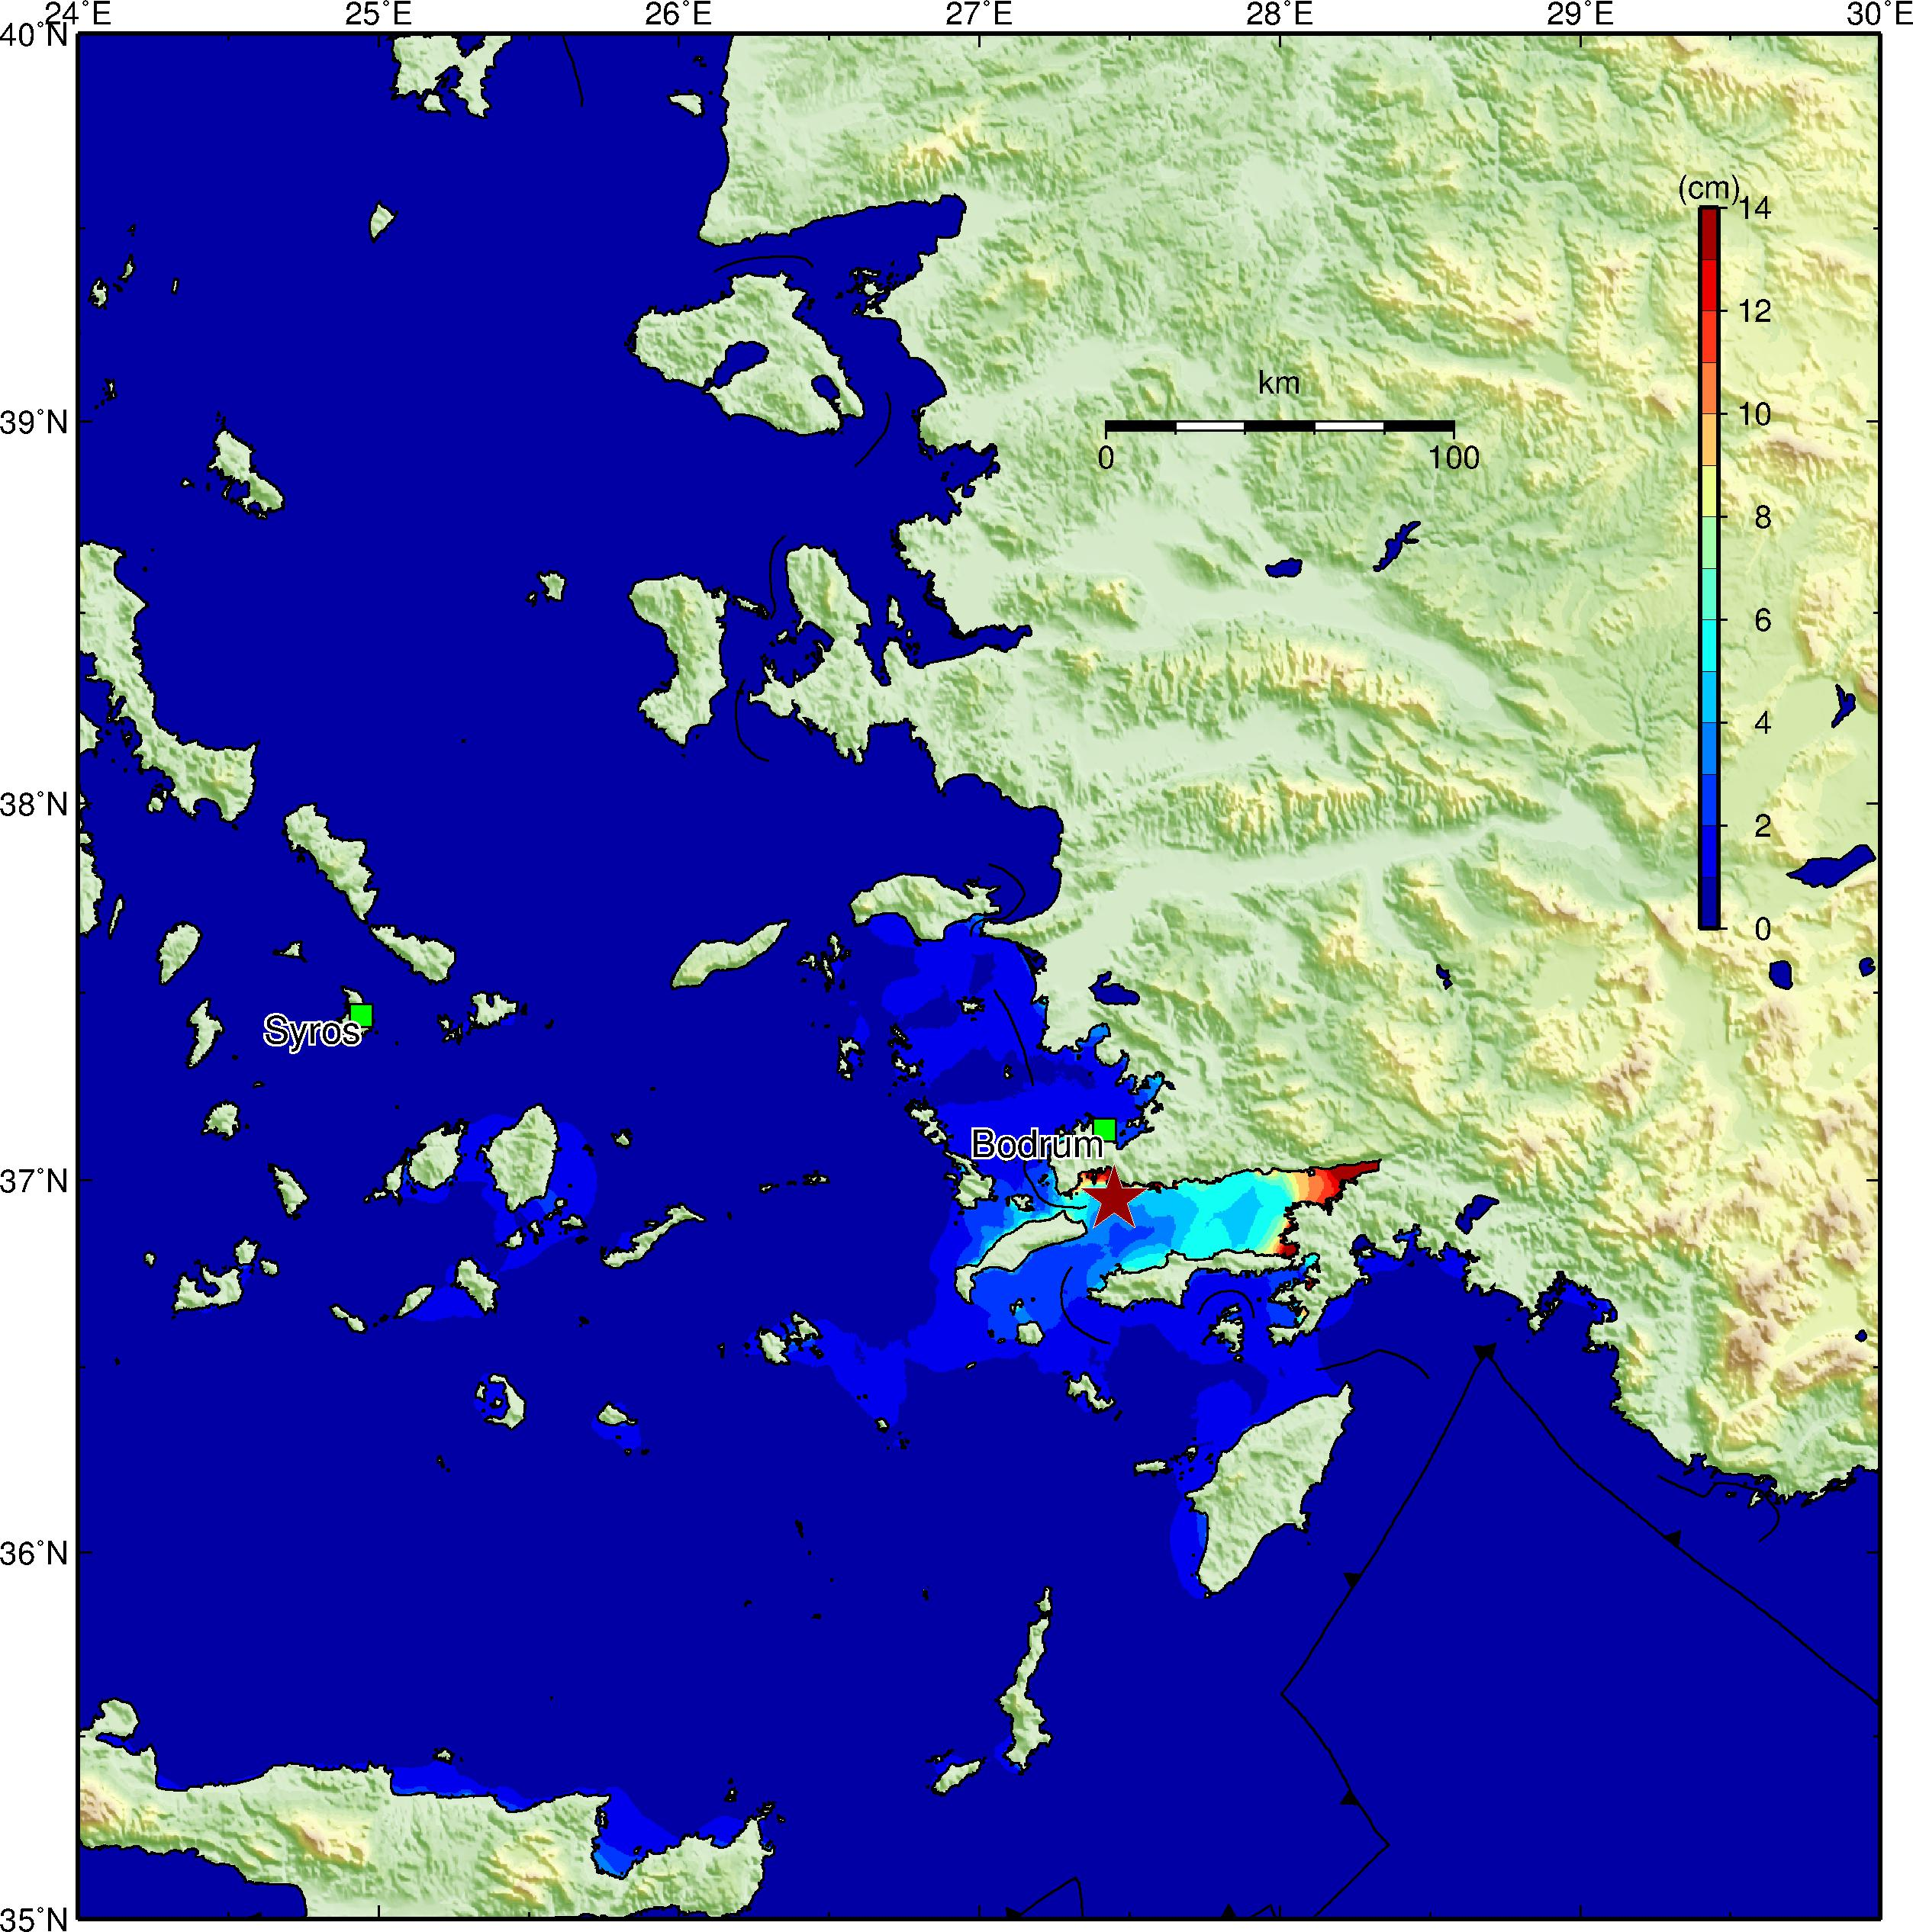
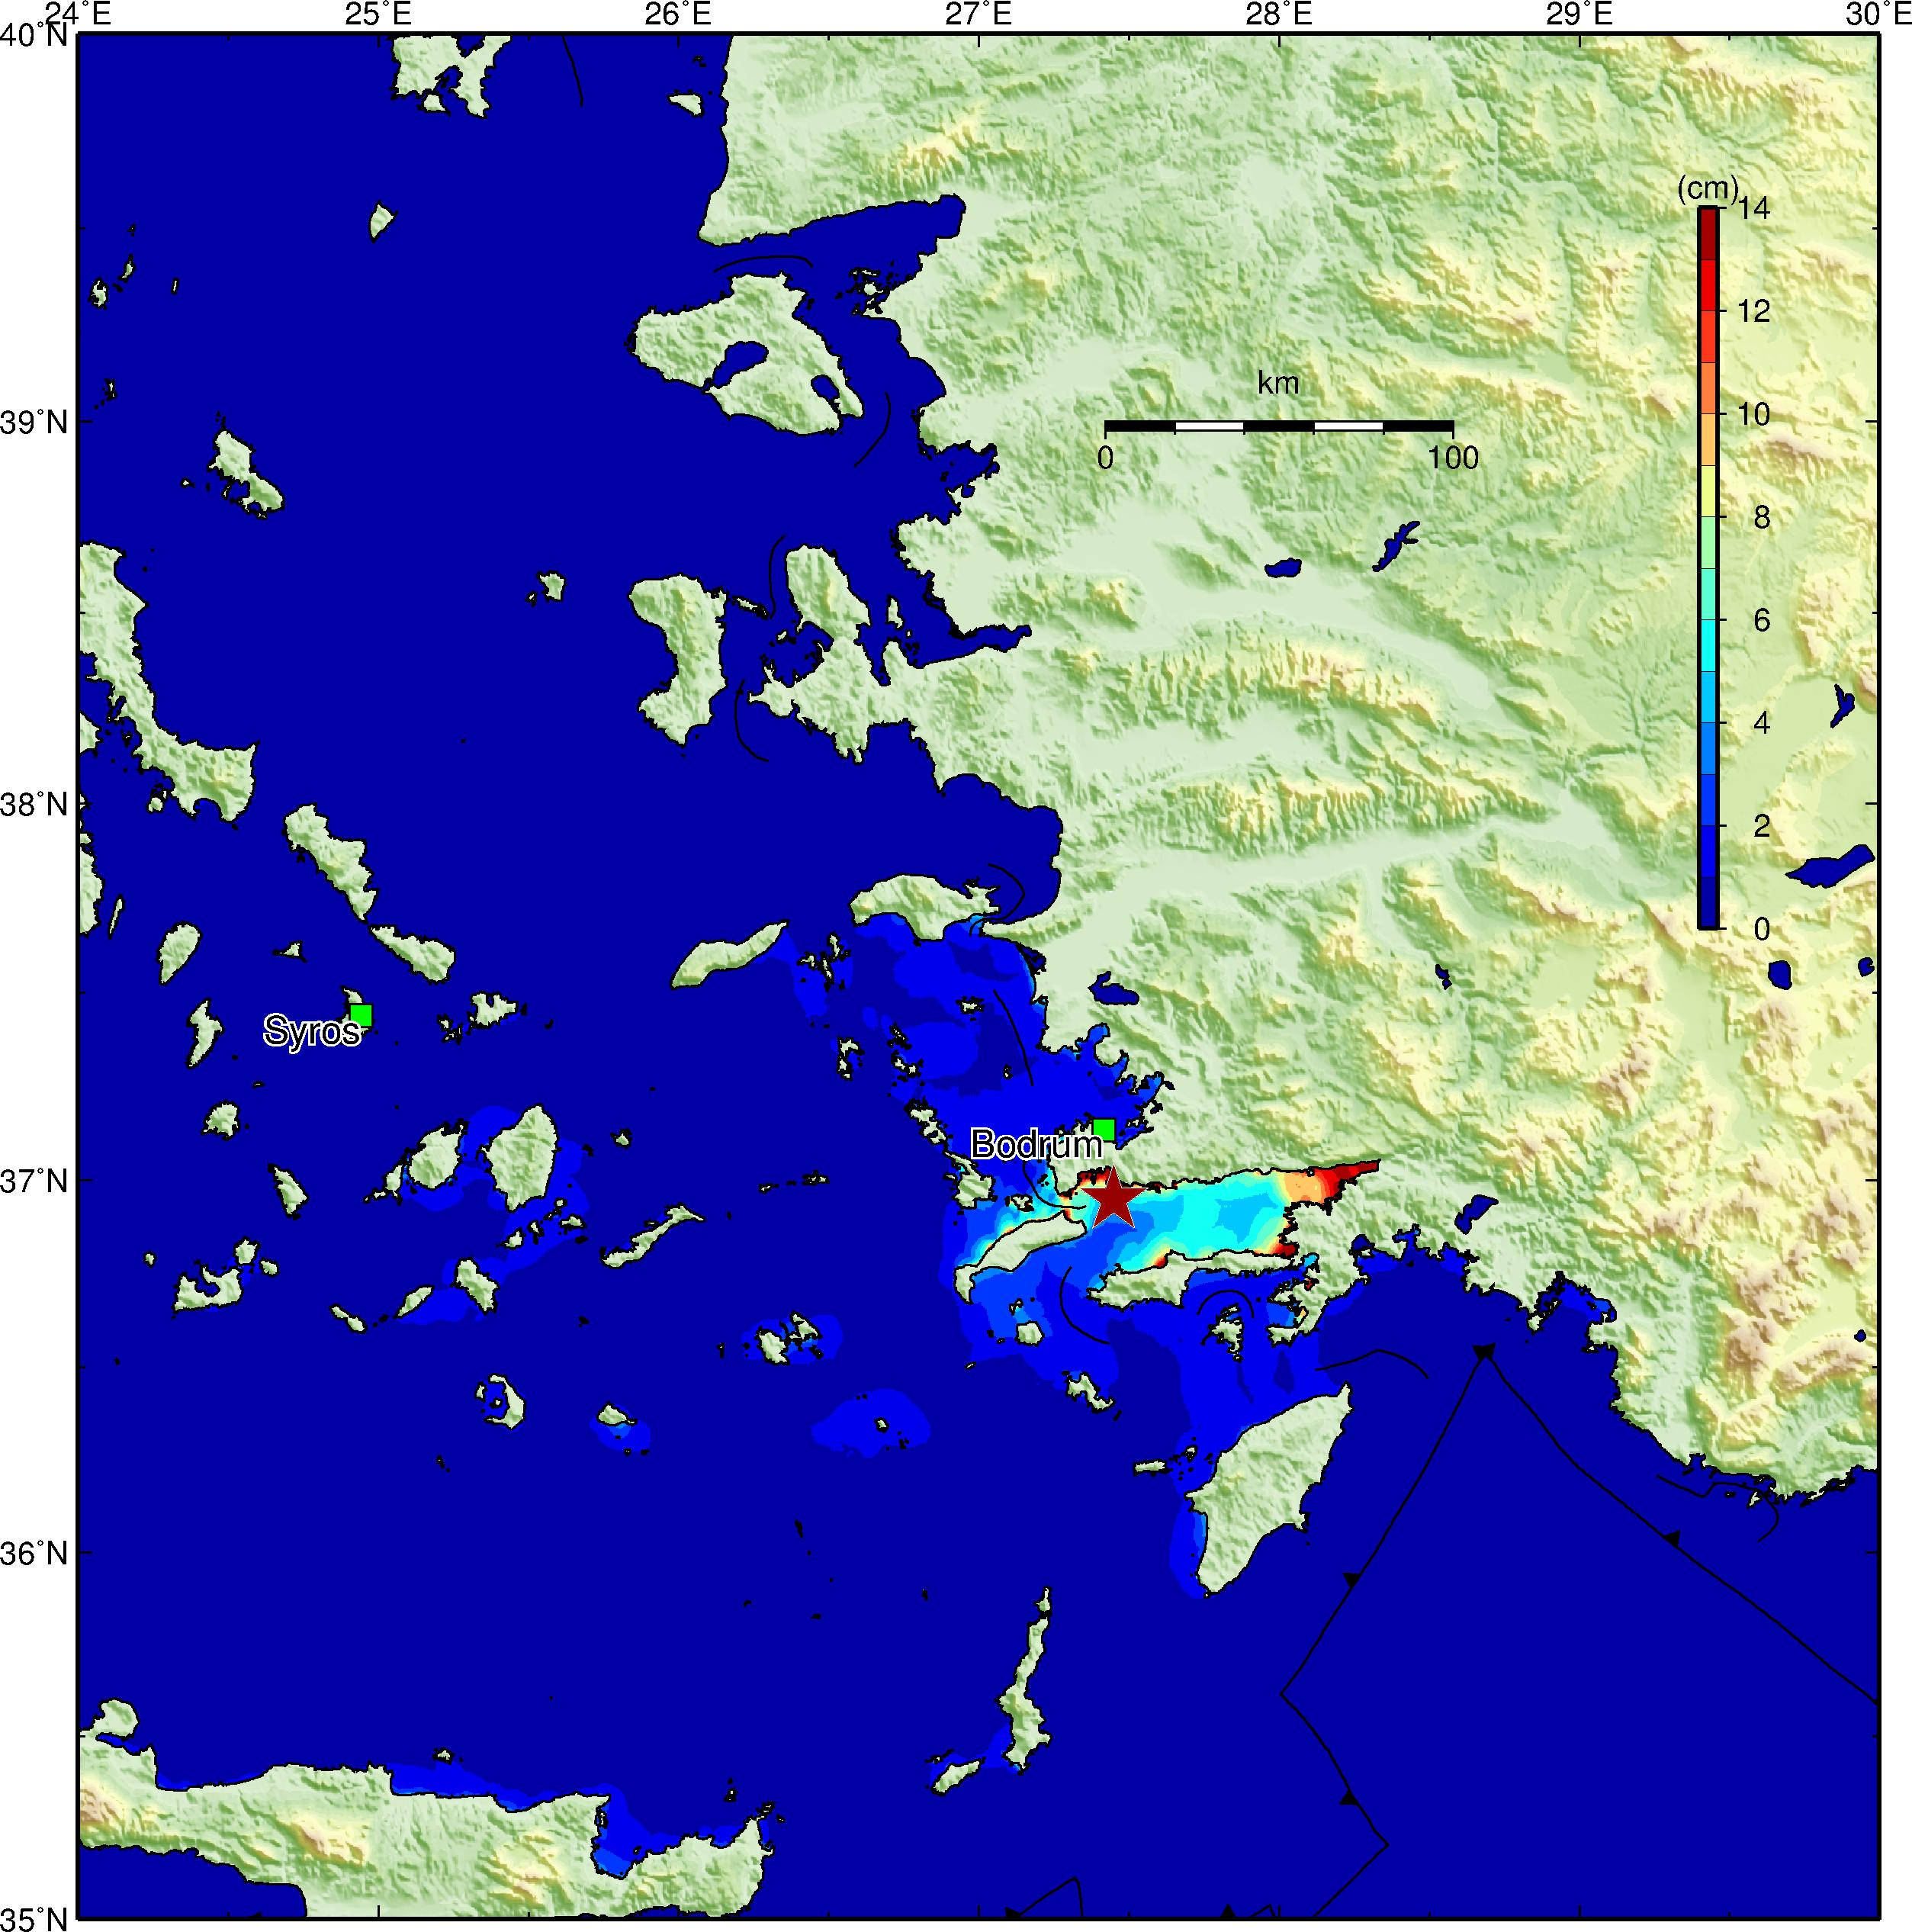
Maximum Tsunami Height
Case NP1
Case NP2

Slide 9
Comments
The observed tsunami waveforms were taken from IOC website (http://www.ioc-sealevelmonitoring.org).
The location of Bodrum tide gauge station was adjusted based on the location of the closest city.
We removed tidal signals by fitting a simple polynomial functions.
The maximum tsunami height in both cases is about 50cm.

